Slide 1
UE20CS461A – Project Phase – 2
END SEMESTER ASSESSMENT
Project Title : PAYCRYPTO – A Fintech Application for the Currency of the Future
Project ID : 127
Project Guide : Prof. Gauri Sameer Rapate
Project Team : 1) Aryansh Garg
2) Harsh Agrawal
3) Harshit Sharma
4) Sagarikha M.

Slide 2
Outline
Abstract
Summary of Requirements and Design ( Phase - 1)
Summary of Methodology / Approach (Phase - 1)
Design Description
Modules and Implementation Details
Project Demonstration and Walkthrough
Test Plan and Strategy
Results and Discussion
Lessons Learnt
Conclusion and Future Work
References

Slide 3
Abstract
Since we know that the buzz of cryptocurrency is growing exponentially and everyone is eager to try their hands on this new era currency, but the knowledge and awareness about it is quite low among the common people.
It takes a lot of time and efforts to get yourself educated in this domain which not many people are willing to spare and an additional challenge is how to find the reliable source of knowledge in this era of scams.
To overcome all these challenges and to provide people with one stop solution we are building PAYCRYPTO. It is an application from where people can start their crypto journey with minimum efforts.

Slide 4
Abstract
When it comes to transactions and investments, cryptocurrencies function much like conventional currency. Through the use of the stock market and transactions with both individuals and companies, it is possible to use this platform in a manner similar to that of managing fiat currencies such as dollars and rupees.
This platform's sophisticated price prediction feature—which is intended to predict the swings in value of well-known cryptocurrencies—is a strong argument for using it. By providing customers with early access to anticipated price movements, this service helps them reduce investment risk by allowing them to plan ahead and make the best possible investment decisions.
In addition to that, the users can do transactions to other users in cryptocurrencies as major companies like tesla and ford have already started accepting cryptocurrency as their mode of payment and in the coming future all the companies are going to do the same.

Slide 5
Summary of Requirements and Design
Functional Requirements:
Crypto Price Prediction
Wallet Creation
Buying and Trading Crypto
Peer-to-Peer Crypto Transfers
Non-Functional Requirements:
Performance Requirement
Security and privacy Requirements
Usability Requirements

Slide 6
Summary of Methodology / Approach
Research Project
Proposed Methodology
Model Architecture
Details of the approach- benefits/drawbacks
Prototype/Product based Project
Design Approach followed with description and technologies used.
Highlight if there are alternative approaches chosen after phase – 1,explain why, including its advantage.
Add 1 – 2 slides.

Slide 7
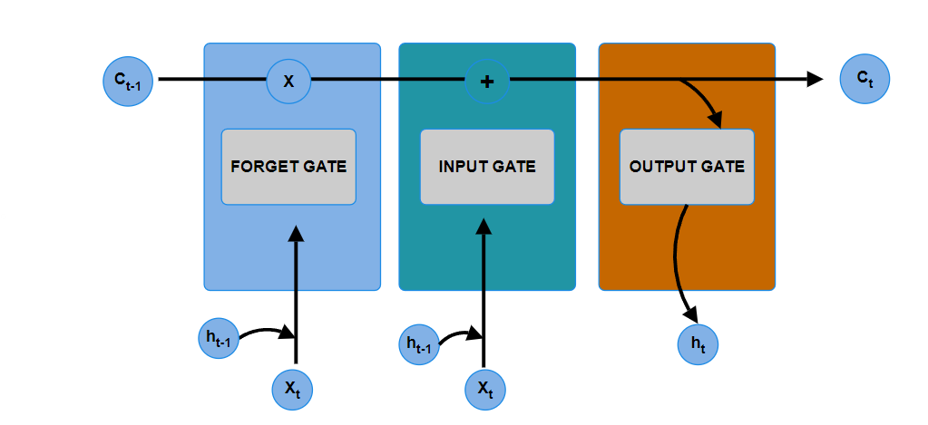
Summary of Methodology / Approach
ALGORITHMS :
LSTM : Long Short-Term Memory (LSTM) networks are a modified version of recurrent neural networks, which makes it easier to remember past data in memory. The vanishing gradient problem of RNN is resolved here. LSTM is well-suited to classify, process and predict time series given time lags of unknown duration. It trains the model by using back-propagation. In an LSTM network, three gates are present:

Slide 8
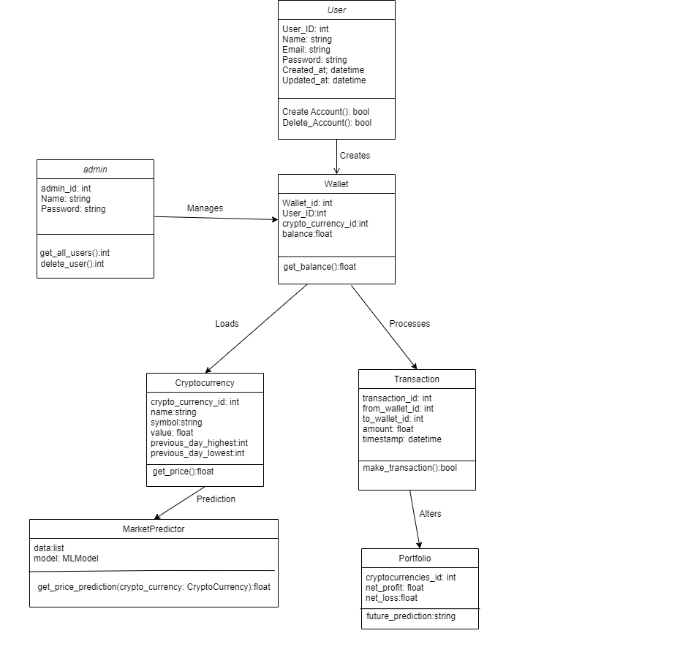
Design Description
Master Class
Diagram:

Slide 9
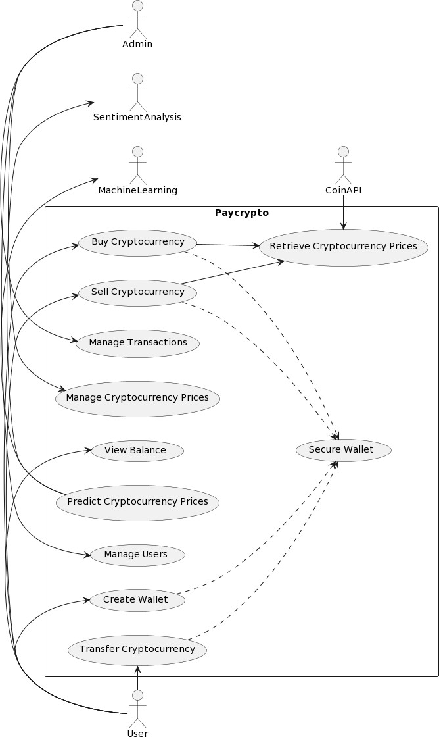
Design Description
Use Case Diagram:

Slide 10
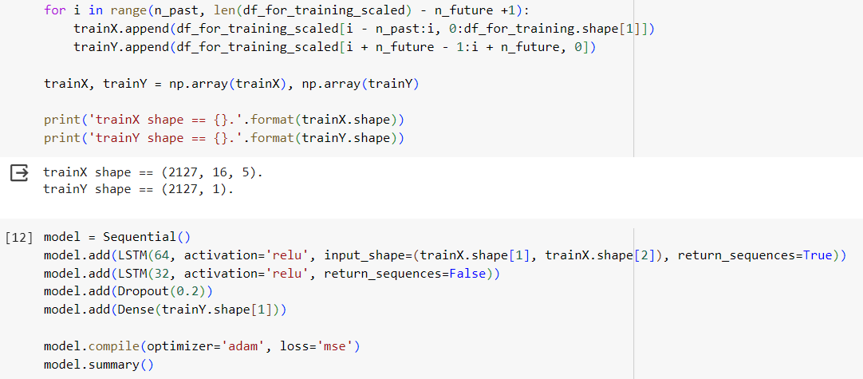
Modules and Implementation Details
Price- prediction:
For price prediction, multivariate LSTM model has been implemented. The model uses five features for the forecasting. Since it is a multivariate model, only one day prediction is possible.
Two LSTM layers, one dropout layer and one dense layer has been implemented

Slide 11
Modules and Implementation Details
Price- prediction:
For price prediction, multivariate LSTM model has been implemented. The model uses five features for the forecasting. Since it is a multivariate model, only one day prediction is possible.
Two LSTM layers, one dropout layer and one dense layer has been implemented

Slide 12
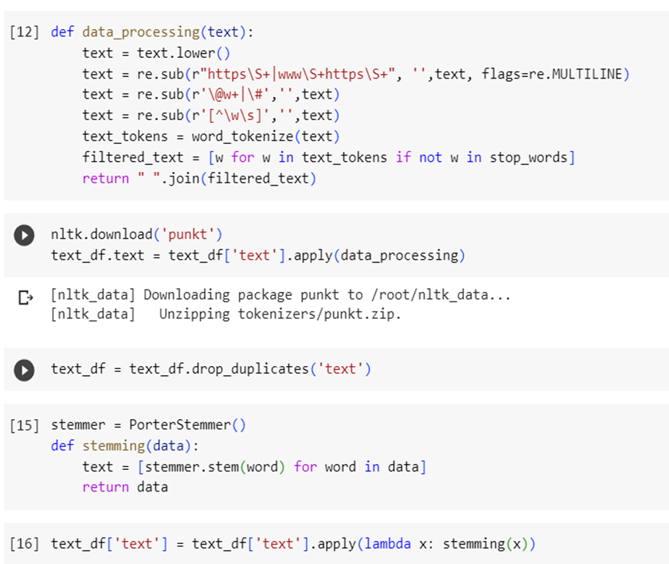
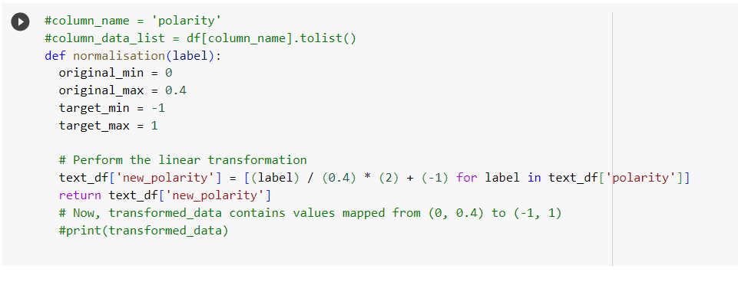
Modules and Implementation Details
Sentiment analysis:
For sentiment analysis of news data, Textblob is used to get the
sentiment of the news headlines.
The sentiment score is then further normalized to give the value between -1 and 1 where the lesser the value, the negative the sentiment.

Slide 13
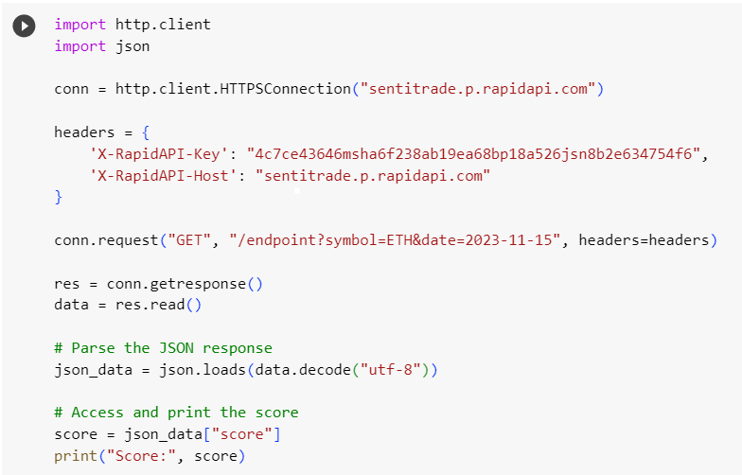
Modules and Implementation Details
Sentiment analysis:
For getting the news data of everyday, SentiTrade API has been
implemented which scrapes the news headlines related
to the cryptocurrency market.

Slide 14
Project Demonstration
Exhibit the working demonstration of complete project.
It has to be complete in all aspects
Data set creation needs to be showed wherever applicable.
Note :
If any special facility required, please make sure that you have that set up. For example, if Internet connectivity is required, please have your mobile or hotspot set up.

Slide 15
Walkthrough
Demo and Product walk thru

Slide 16
Test Plan and Strategy
For testing the different modules of the project, unit testing method has been followed since all the different modules provide different functionality and each one has to be working independently.
For the frontend part, as it has been build in react JS component testing is followed.
API testing has been performed using postman.
Finally, integration testing has been done to test the feasibility and working of all the modules together

Slide 17
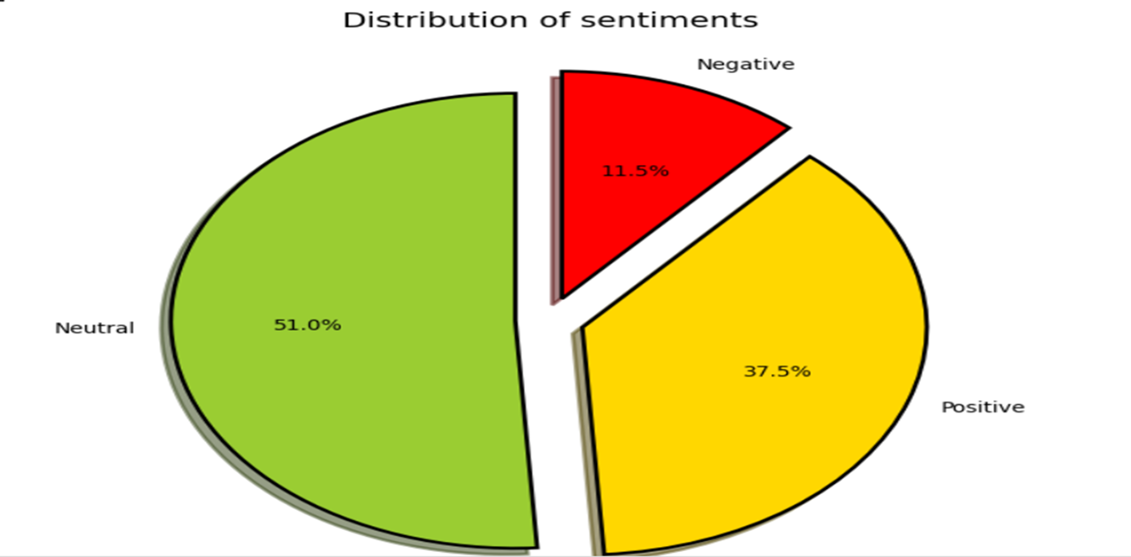
Results and Discussion
For sentiment analysis of news data, after the dataset preprocessing the following results have been obtained for sentiment distribution.

Slide 18
Schedule
Discussion of how well the schedule was met.
You can add a table,
planned efforts (as per initial estimates) and actual efforts.
If there is a deviation, what is the reason for the change.

Slide 19
Documentation
Show the evidences, status of the below documents:
Project report submitted in department?
IEEE (similar) Format of Paper current status? Which Conferences are you targeting?
Video (2-3 minutes) of your project? Please Play.
Add the Github repository link.
All artifacts of your project uploaded in the CSE Project repository?

Slide 20
Lessons Learnt
Discuss on the lessons learned and what you could have done differently knowing what you now know
Give an overview of issues that has been overcome in this project.

Slide 21
Conclusion and Future work
TextBlob for news sentiment analysis provides satisfactory results by giving the sentiment score between -1 and 1 where lesser score means negative sentiment and higher score means positive sentiments and near zero infers neutral sentiments.
For the price forecasting, LSTM model provides satisfactory results which has been implemented with 2 LSTM layers, one dense layer and one dropout layer.
In the future, licenceing and permissions can be obtained to provide wallet to the users for the transactions and buying currencies.

Slide 22
References
Provide references pertaining to your research according to IEEE format.
Example:
G. Eason, B. Noble, and I. N. Sneddon, “On certain integrals of Lipschitz-Hankel type involving products of Bessel functions,” Phil. Trans. Roy. Soc. London, vol. A247, pp. 529–551, April 1955. (references)

Slide 23
Any other information
Provide any other information you wish to add on.
Note: Changes can be made in the template, with the consent of the guide for inclusion of any other information.

Slide 24
Thank You

